Slide 1

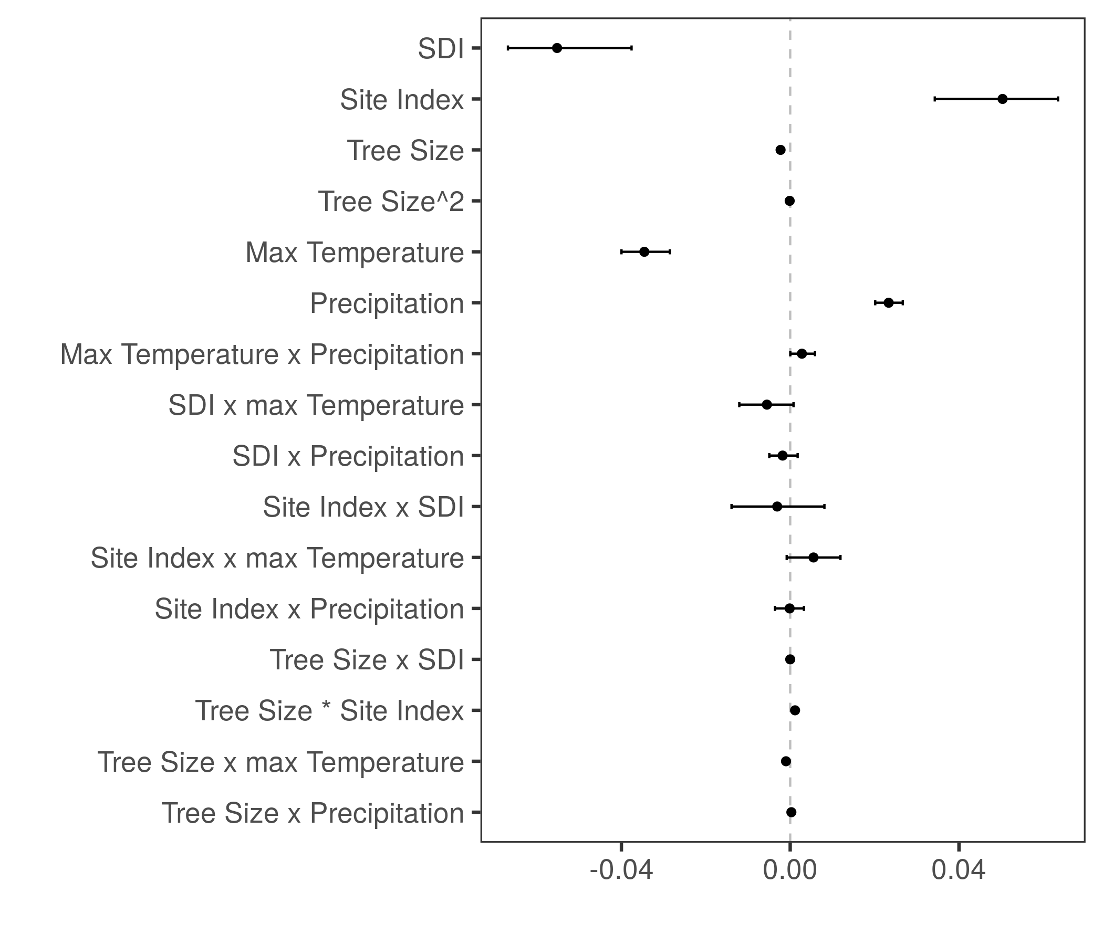
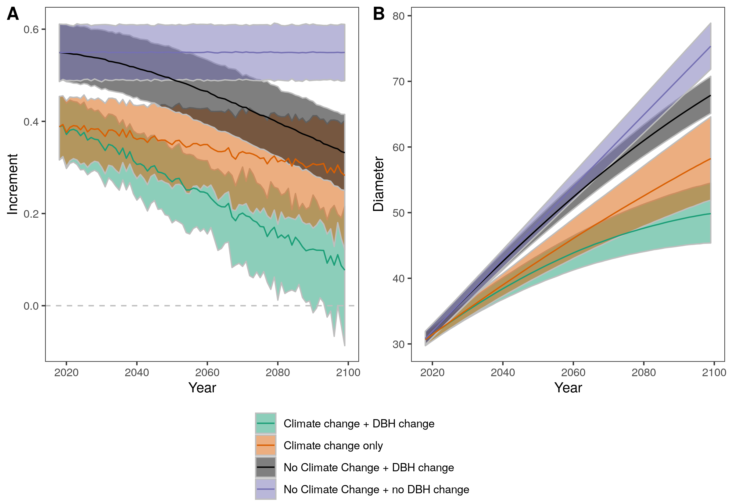

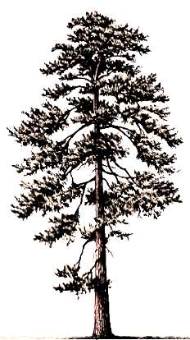

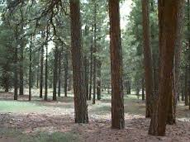

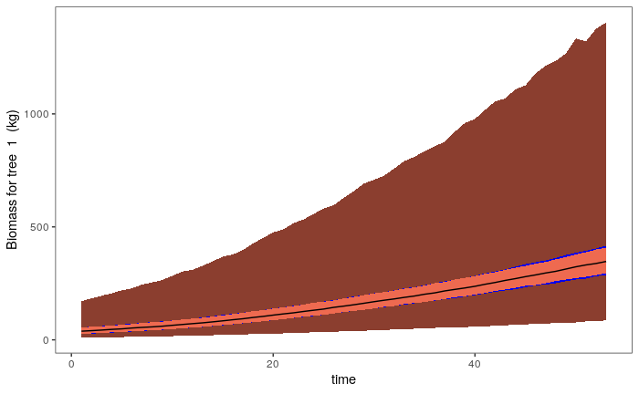
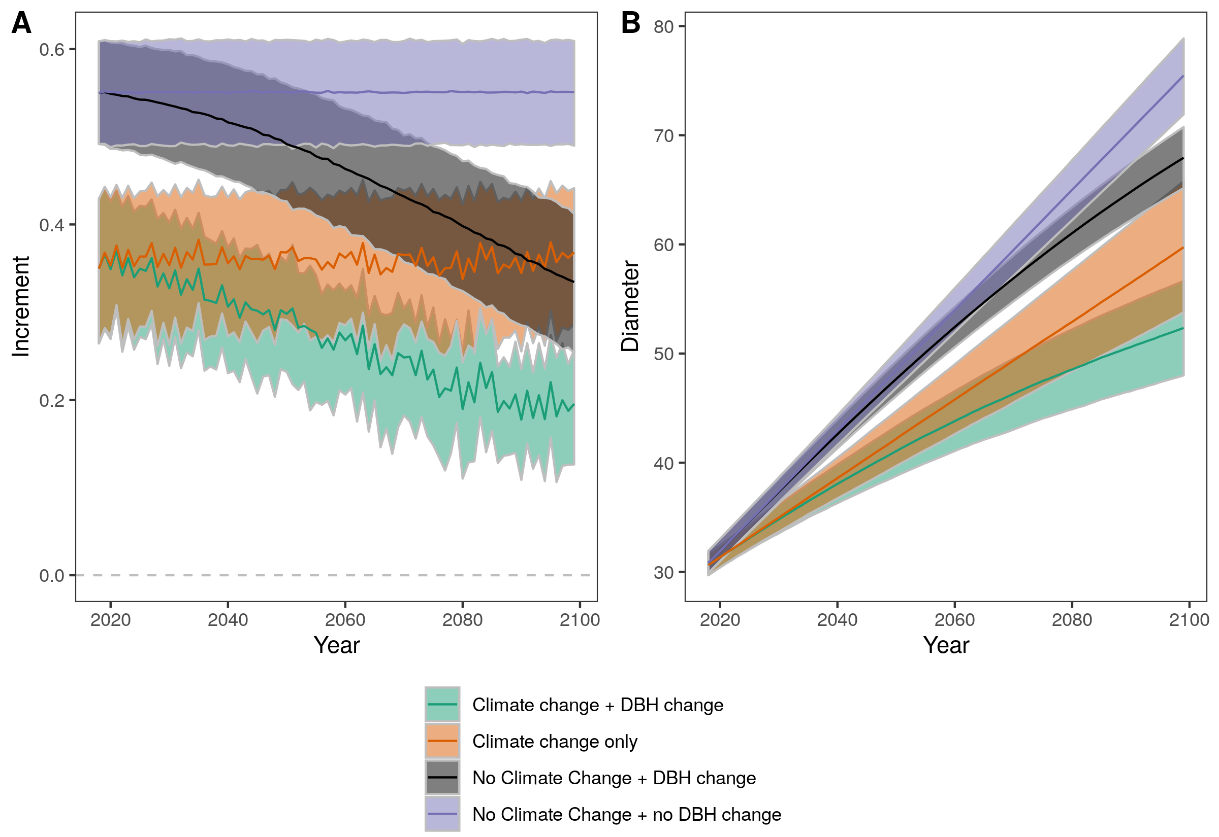

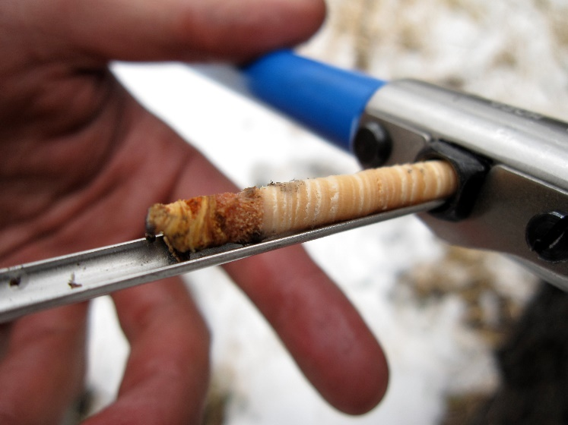

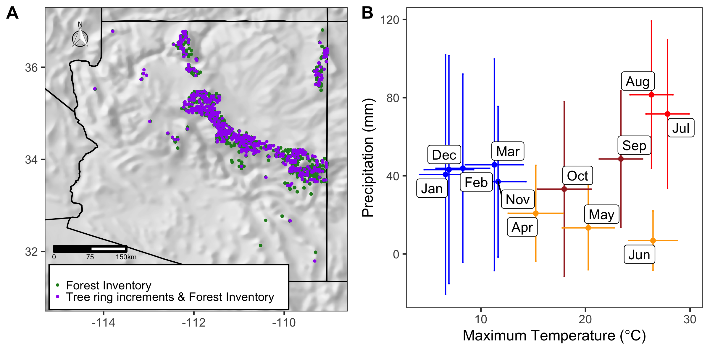
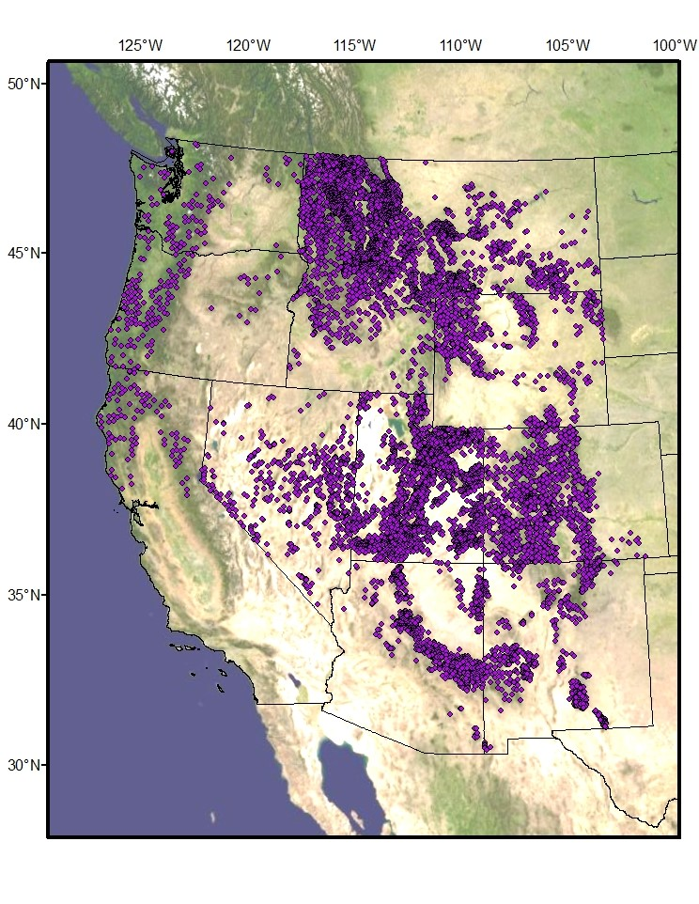
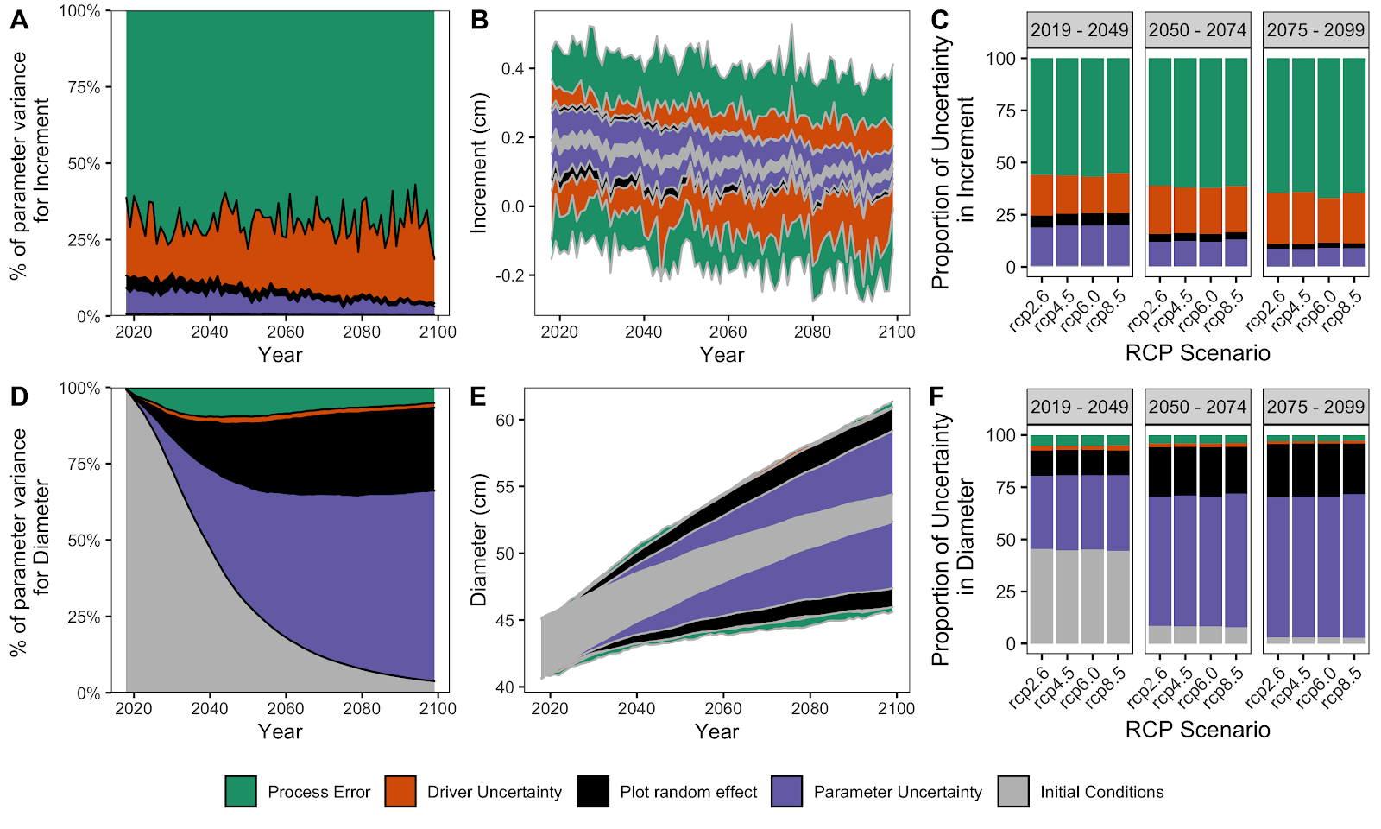



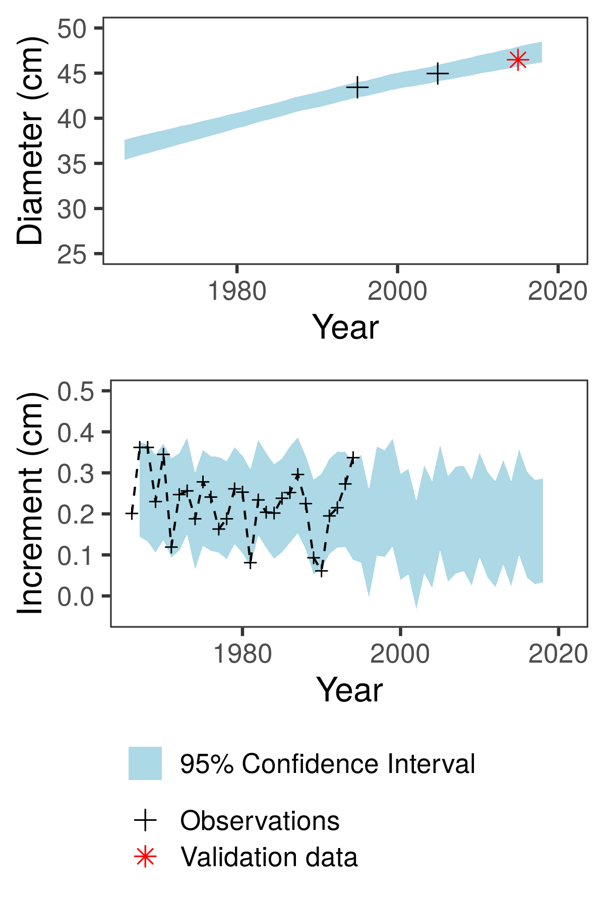










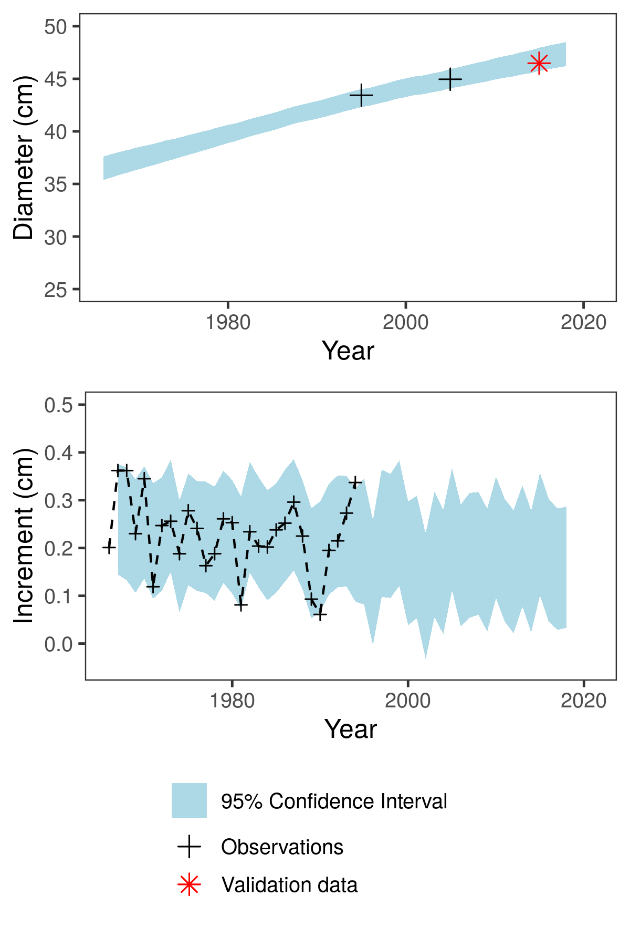

Carbon accounting of ponderosa pine forests across the interior western U. S. based on tree-ring and forest inventory data
1. Motivation
3. Ecological Forecasting
4. Next: scaling up
Feedbacks between forests and climate lead to high uncertainty about the future land carbon sink.
A). Estimate drivers of Tree Growth
B). Forecast tree growth
Stand level biomass & carbon accounting
Friedlingstein et al. 2014
source
∑
+
Forests
Climate
BIOMASS INCREMENT
sink
allometric equation
sum across trees
Increment (cm)
DIAMETER
TREE-LEVEL BIOMASS
STAND-LEVEL BIOMASS
AGB_{t+1} - AGB_{t}
We take an ecological forecasting approach to model the forest-climate feedback. We explore the patterns and drivers of tree growth and quantify uncertainty around how much carbon will be sequestered as climate changes.
*best model from in & out of sample validation
Δ Climate + DBH
Δ Climate
Δ DBH
No change climate/DBH
2. Data Fusion
Tree Biomass
Total Biomass Uncertainty
Parameter + DBH Uncertainty
Parameter Uncertainty
Miranda Rintoul
+
Climate changes & the effects of tree size result in future declines.
Time
Patterns & drivers of C cycling across spatial scales
annual resolution
temporal depth
covariate data
unbiased sampling design
C). Quantify uncertainty to improve models
DeRose, Shaw, and Long 2017
Journal of Forestry 155(4): 283-291
region
Data Assimilation
(State-space model)
stand
Pinus ponderosa
Proportion of uncertainty for increment
Forecasted increment (cm)
High process error = missing ecological processes
Tree
Forest Inventory and Analysis (FIA) program
Effects of cross-scale interactions between drivers of carbon sequestration
Estimate true DBH + uncertainty
*Ongoing USFS surveys are an opportunity to continuously validate model
Driver uncertainty = Precipitation > temperature driver uncertainty
Proportion of uncertainty for diameter
Forecasted diameter (cm)
High parameter uncertainty = high uncertainty from temperature parameters and ecological interactions
Estimate true increment + uncertainty
Spatially variable climate sensitivity
Heilman
Dietze
Finley
Shaw
DeRose
Evans
NSF Macrosystems Biology-ECA Award # 1802893
kellyannheilman@gmail.com
Twitter: @kelheil

Slide 2


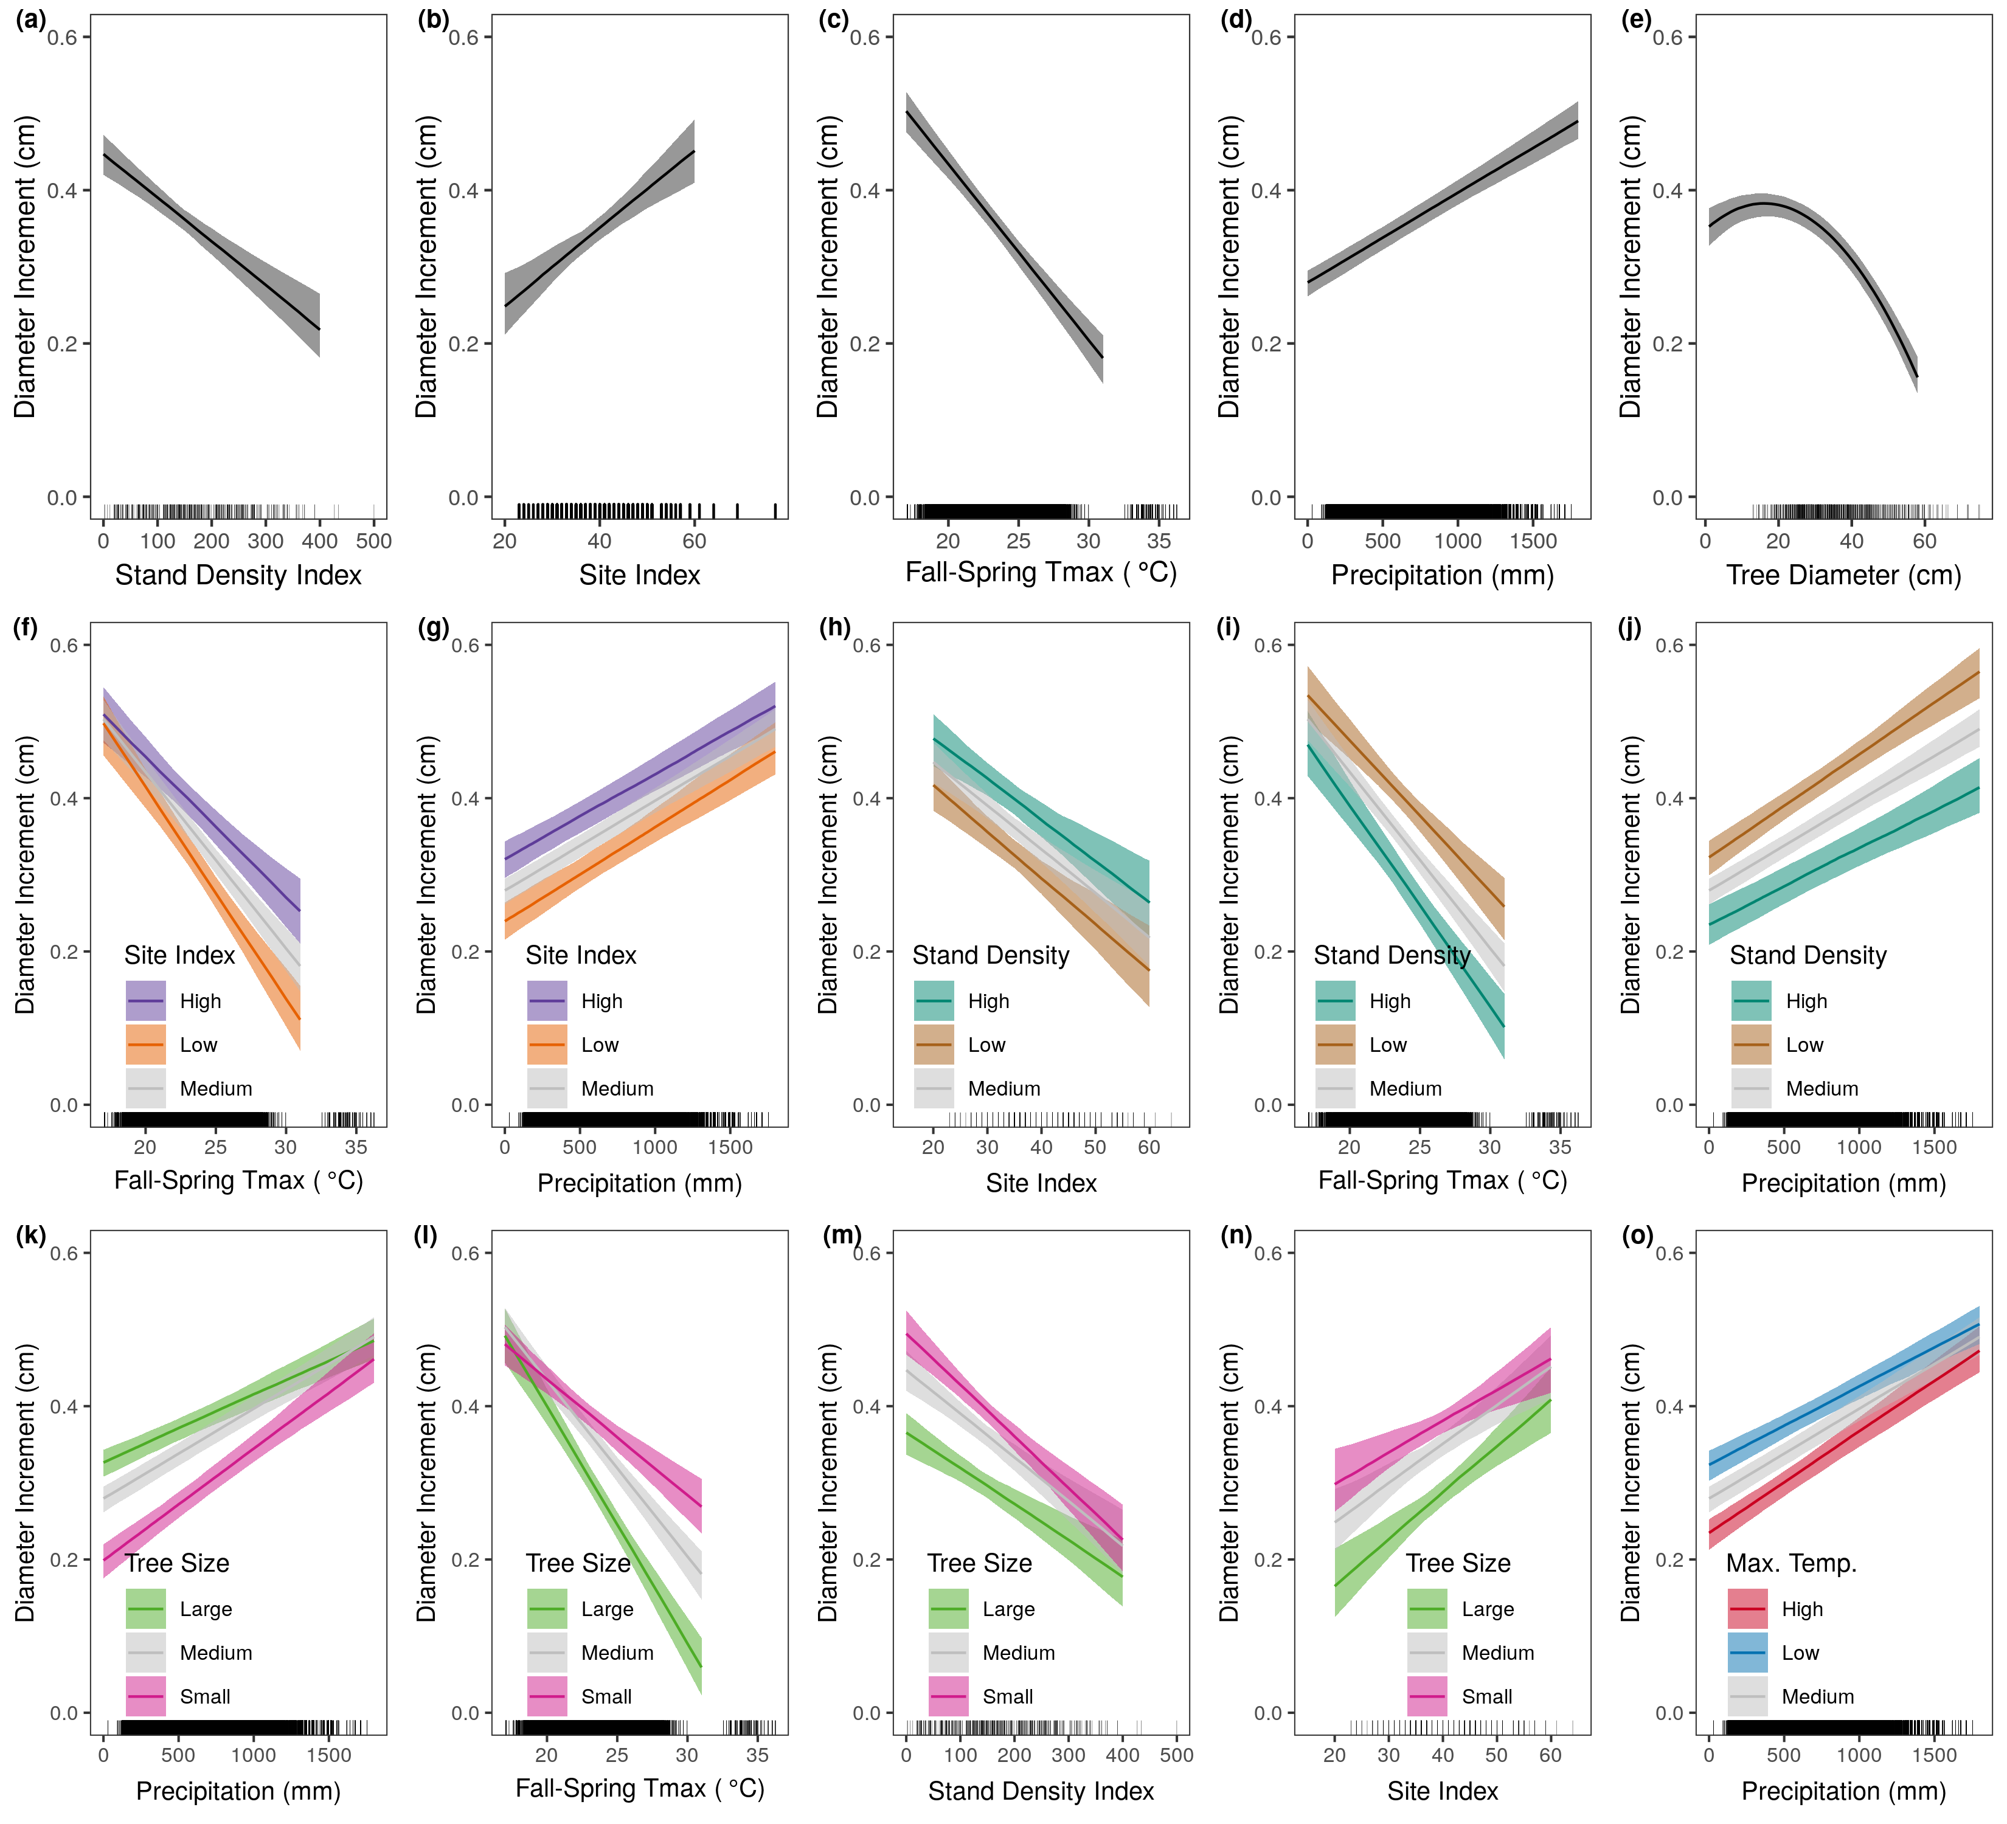
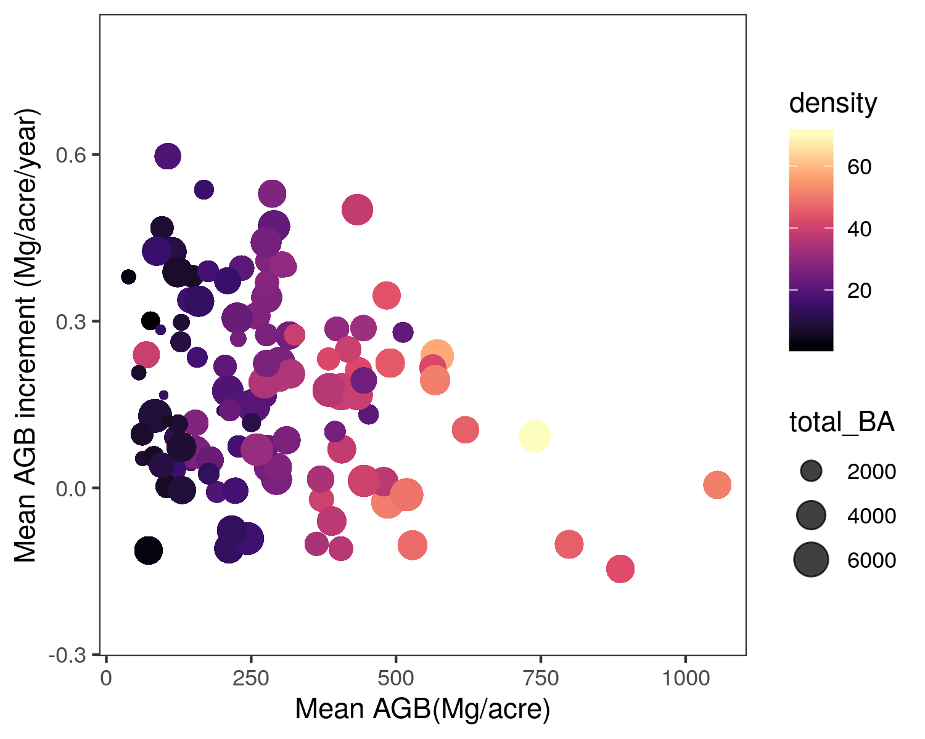
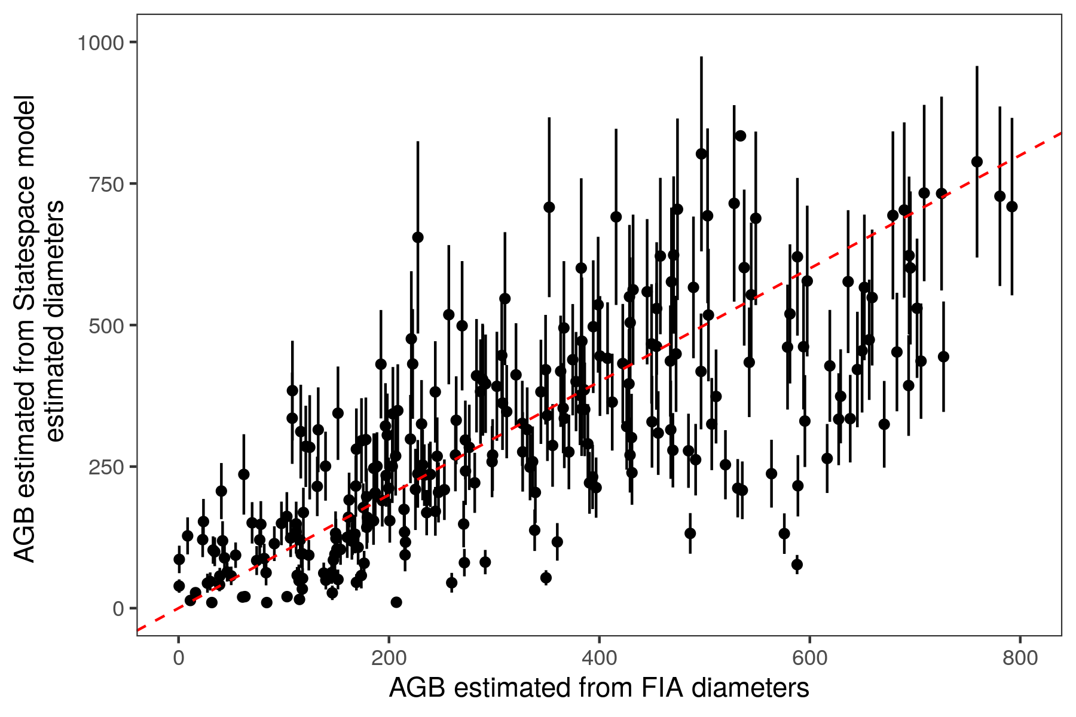
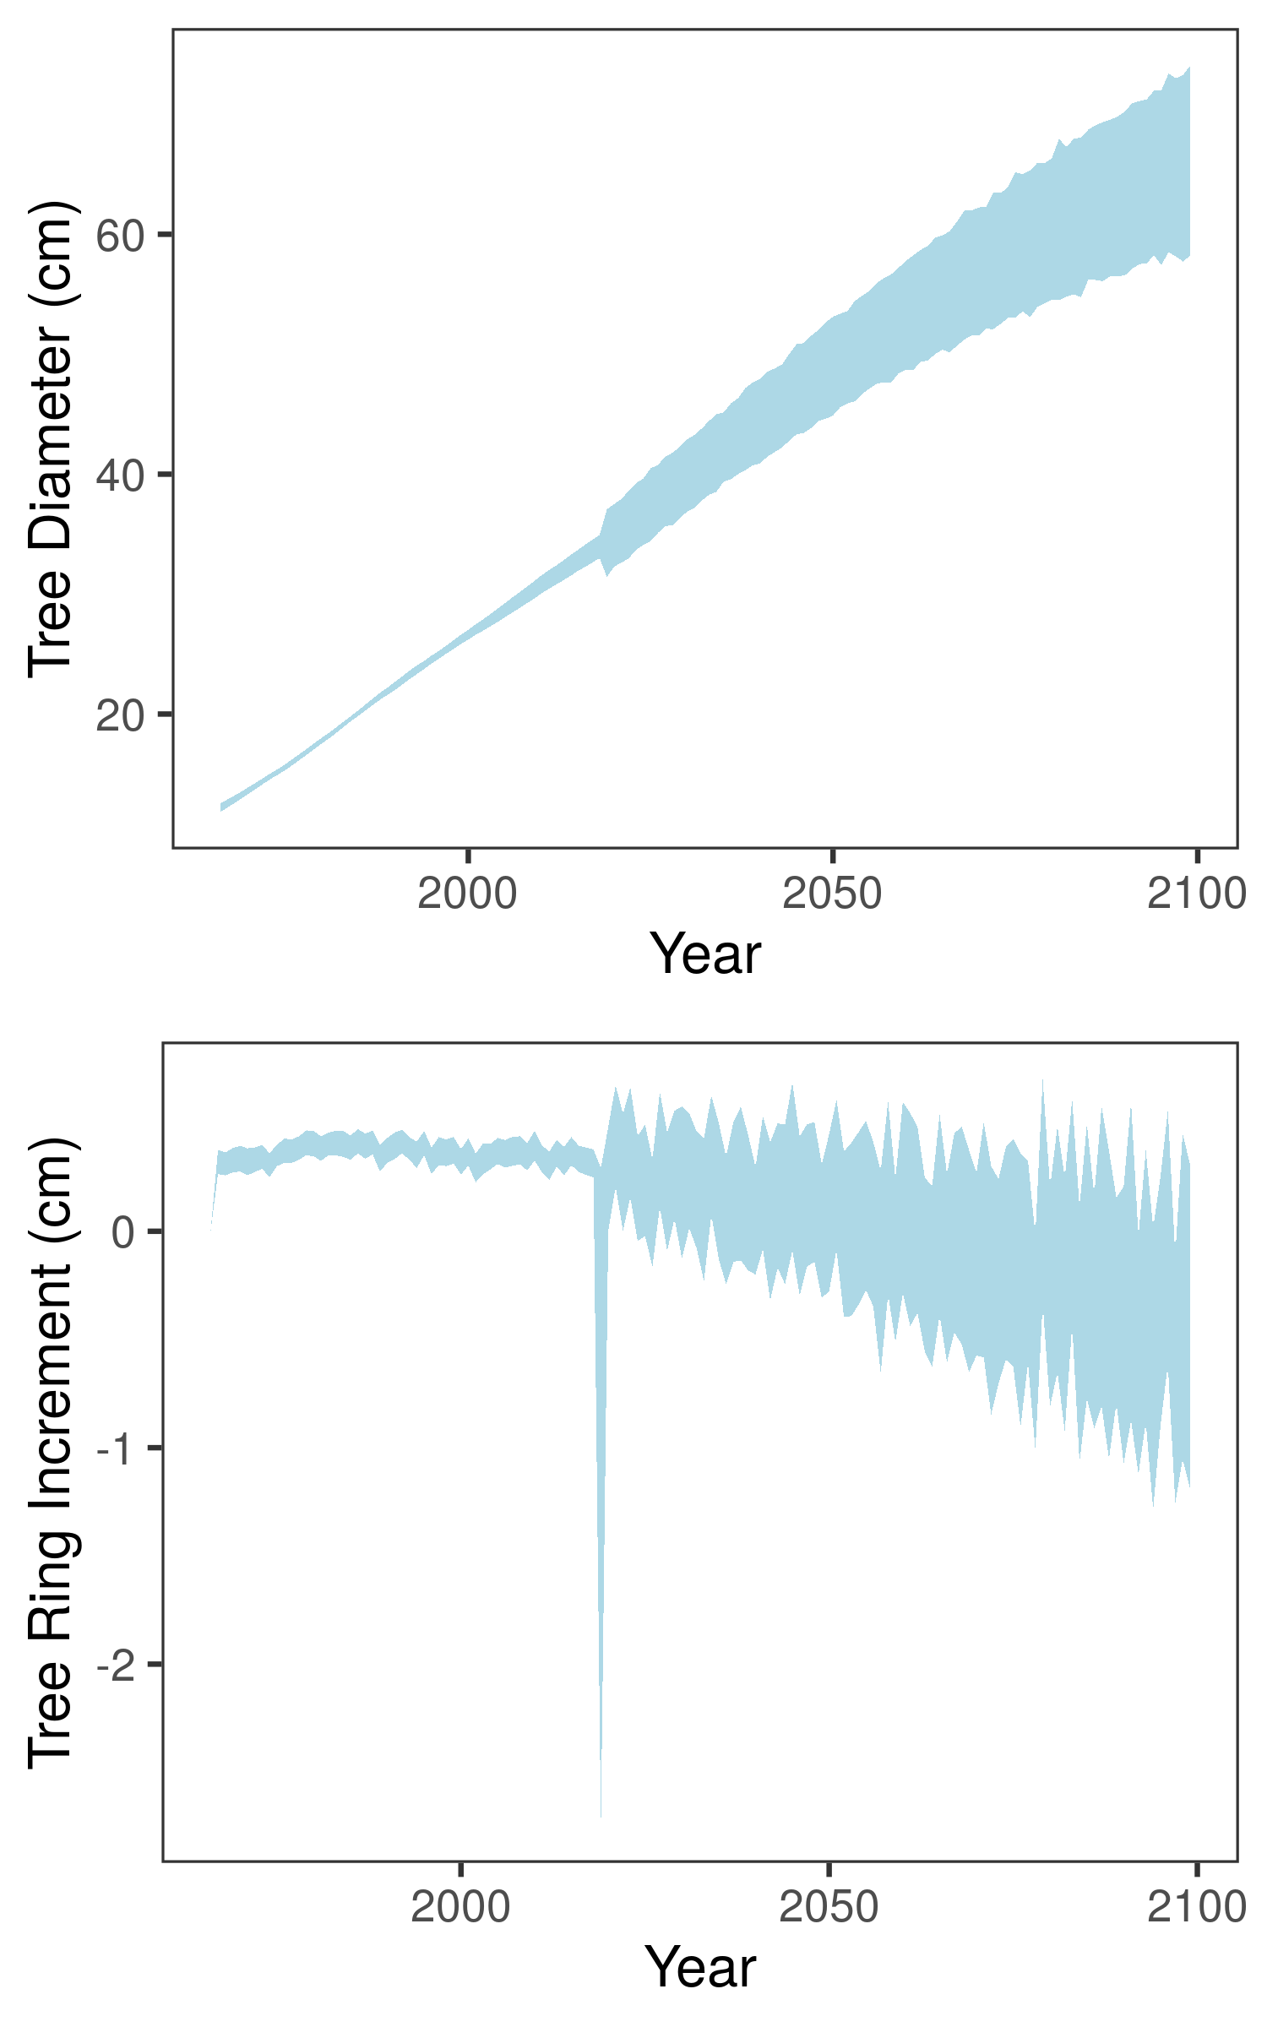
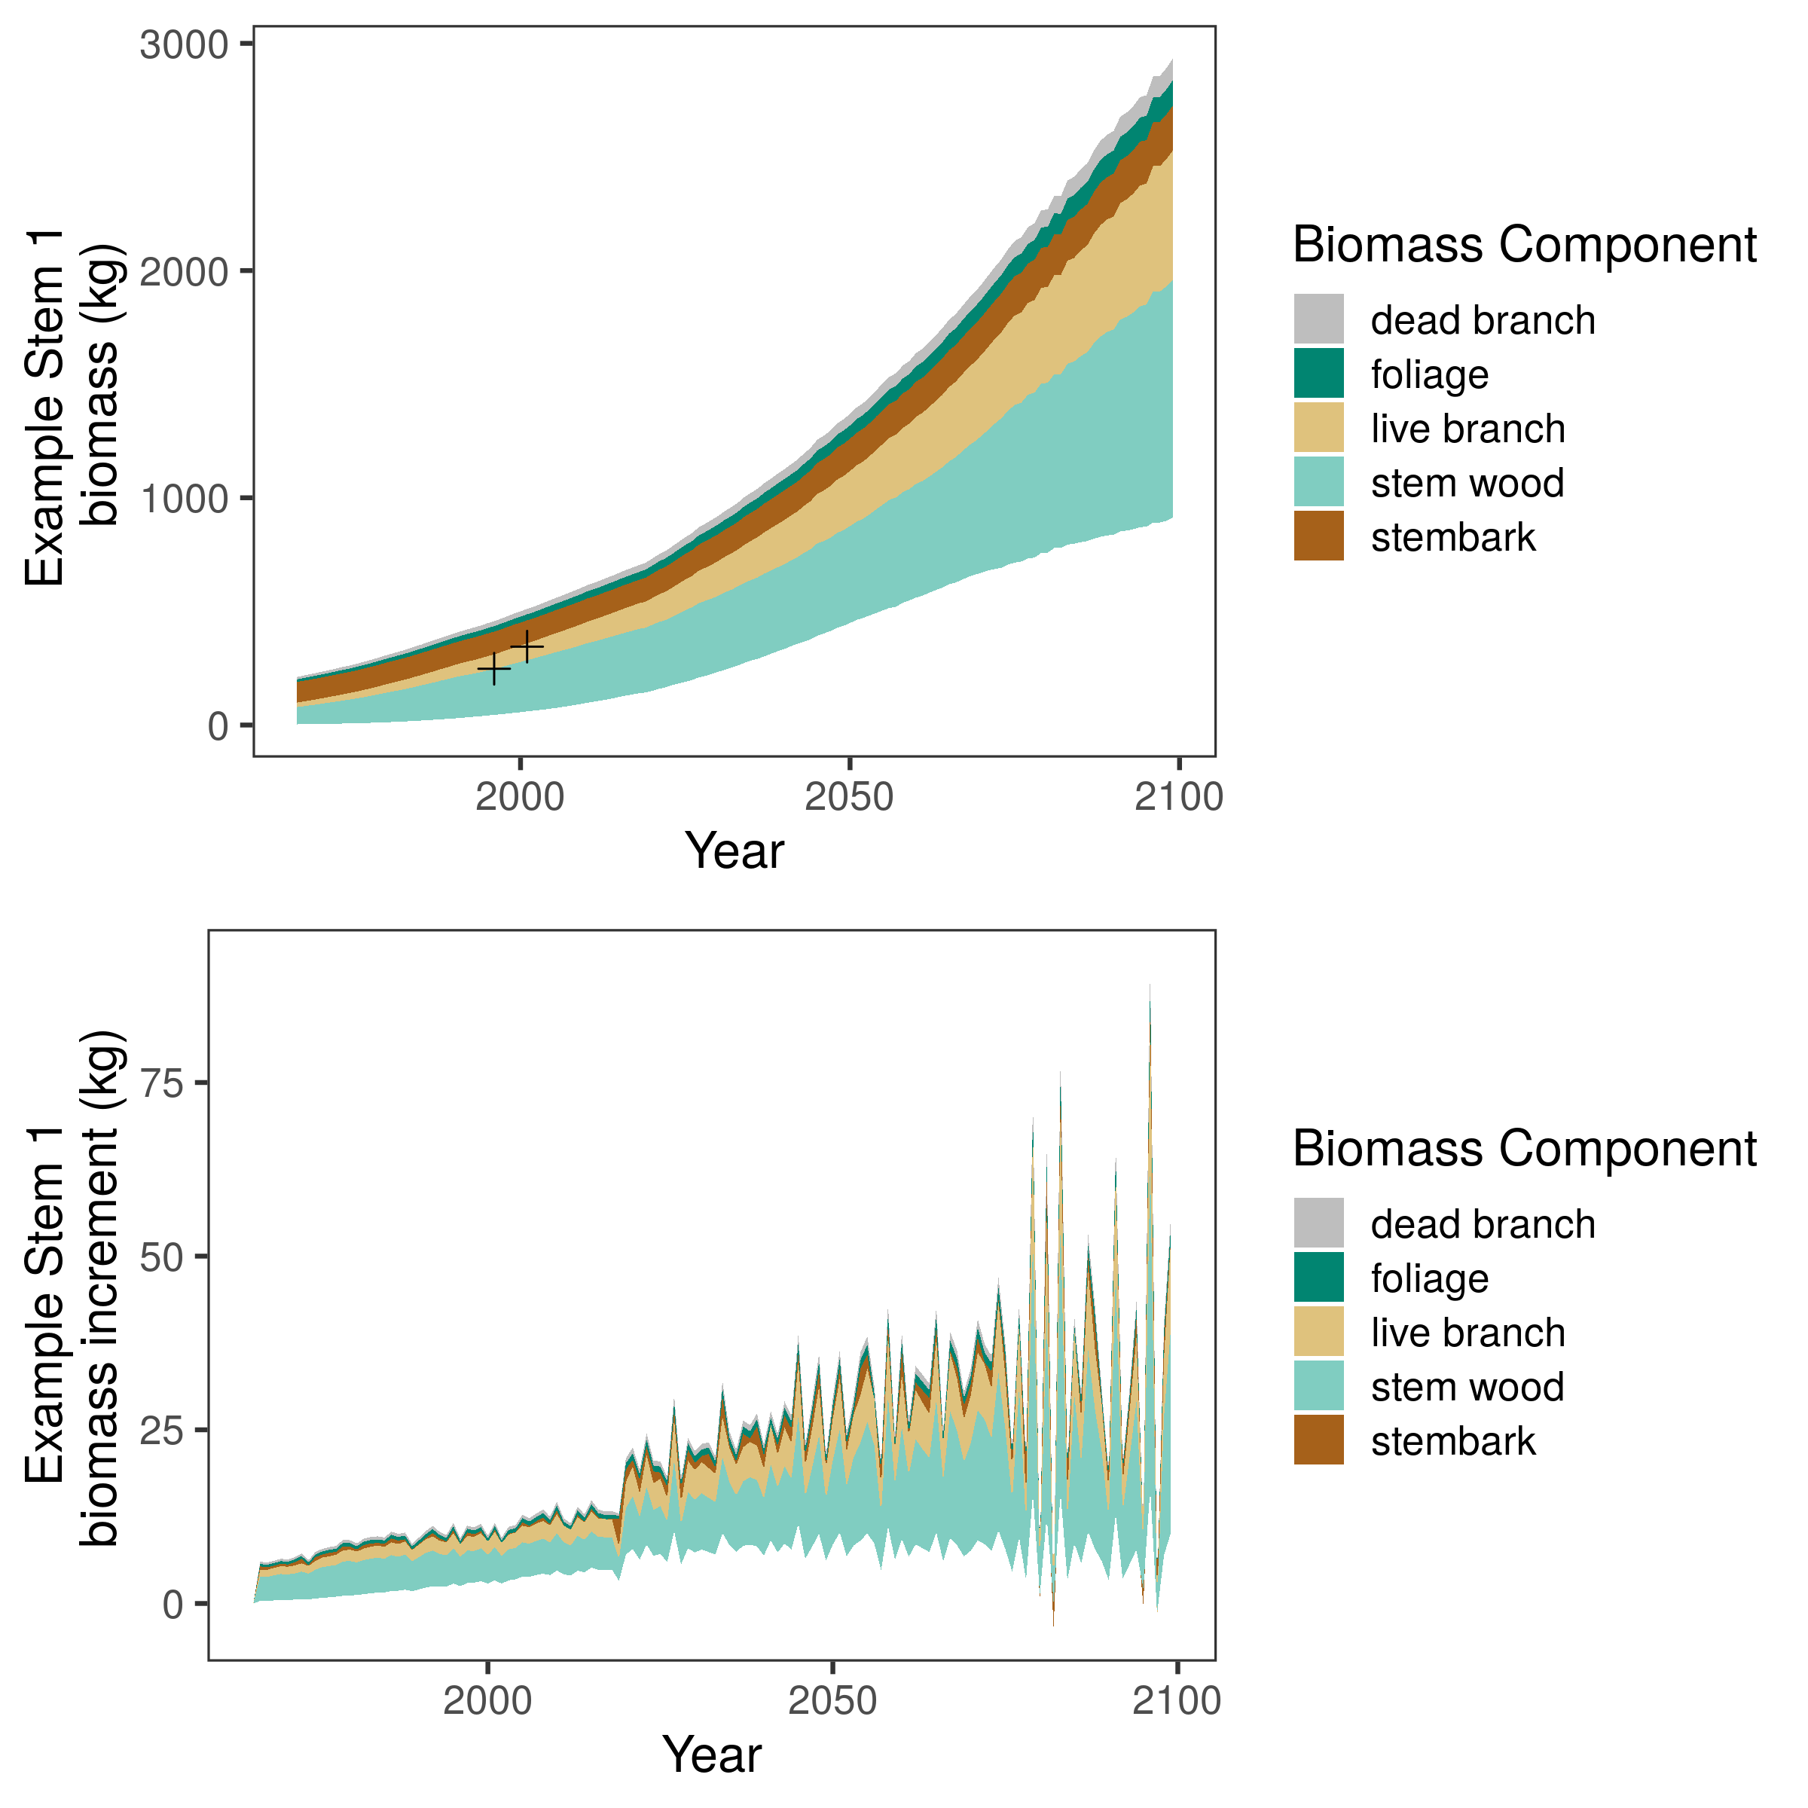
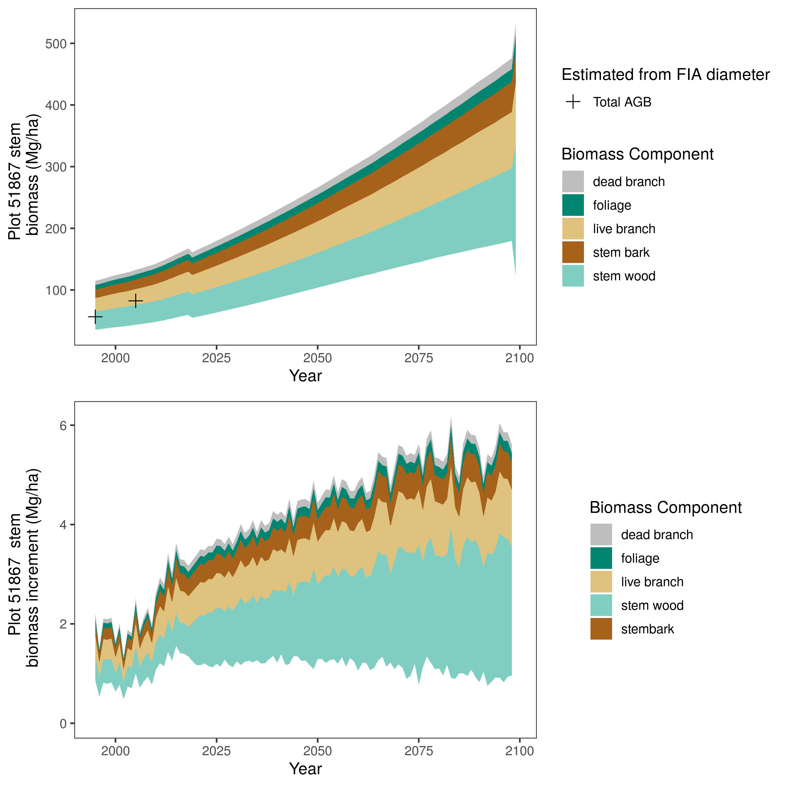

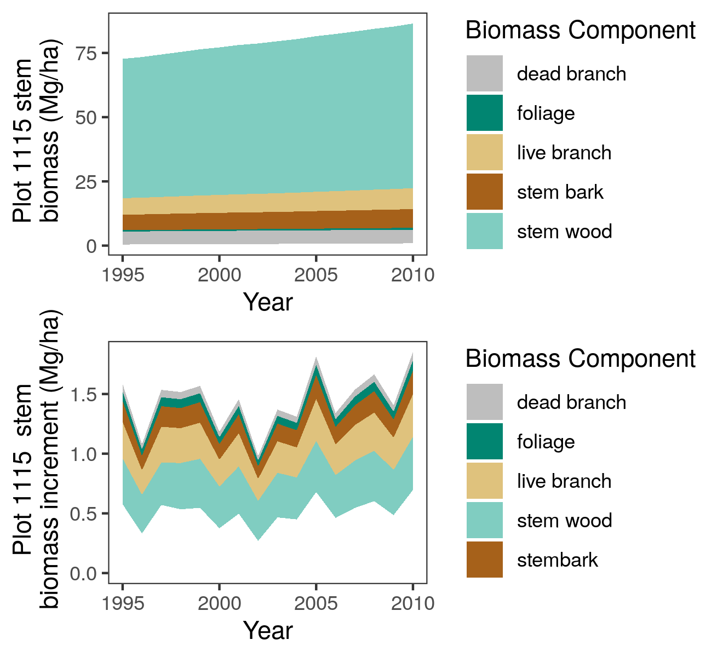
Carbon accounting of ponderosa pine forests across the interior western U. S. based on tree-ring and forest inventory data
B25G-1553
AGU 2021
1. Motivation
3. Ecological Forecasting
4. What we have learned…
Feedbacks between forests and climate lead to high uncertainty about the future land carbon sink.
A). Estimate drivers of Tree Growth
B). Use posteriors as priors to forecast diameter & partition uncertainty
Patterns & drivers of C cycling across spatial scales
Friedlingstein et al. 2014
source
region
Forests
Climate
stand
sink
tree
Forecasted diameter (cm)
Forecasted increment (cm)
We take an ecological forecasting approach to model and quantify uncertainty around the forest-climate feedback. We apply ecological forecasting principles (data fusion, model validation, uncertainty quantification), to build a carbon forecasting system from a forest carbon monitoring system.
*best model for AZ from in & out of sample validation
2. Data Fusion
Enhancing a large monitoring network with models to build a forecasting system.
C). Estimate tree and stand-level biomass from diameter forecasts
Tree Ring Data
Forest Inventory and Analysis (FIA) program
Trees in denser stands in AZ have lower growth and stronger climate sensitivity
Denser stands have the highest biomass in AZ, but C fluxes may saturate in the future
+
pecanproject.github.io
∑
STAND-LEVEL BIOMASS
Turning a monitoring system into a forecasting system:
conclusions & next steps
>900 trees
>10,000 trees
DIAMETER
allometric equations
TREE-LEVEL BIOMASS
sum across trees
covariate data
tree size
stand competition
BIOMASS INCREMENT
annual resolution
climate response
temporal depth
Kaye et al. (2005)
+
Bayesian fusion of tree ring and forest monitoring data allowed us to quantify cross-scale drivers (+ interactions) of forest biomass, and their uncertainties
High allometric uncertainty, and driver uncertainties result in high forecast uncertainty, but more data across the region & improved allometric uncertainty quantification could reduce these uncertainties
Including spatial variability in climate response could reduce uncertainty
Incorporating new inventory data each year will constrain future AGB forecasts, turning the monitoring system into a forecasting system
AGB_{t+1} - AGB_{t}
Data Assimilation
(Bayesian State-space model)
Estimate
Historical climate,
Estimated in SSM,
validated with FIA
+ Aboveground Biomass (FIA)
+ Aboveground Biomass (FIA)
+ Aboveground Biomass (FIA)
DBH_{t} = DBH_{t-1} + inc_{t}
Pinus ponderosa
Tree Biomass (kg)
Plot Biomass
(Mg/ha)
inc_{t} = f(DBH, competition, climate, site quality, two-way interactions)
Forecast
RCP 2.6
SSM posteriors, forced by Ensemble of CMIP5 downscaled climate
Estimate true DBH + uncertainty
*Ongoing USFS surveys are an opportunity to continuously validate and update models
Year
Year
Estimate true increment + uncertainty
Tree Biomass
Increment (kg)
Plot Biomass
Increment (Mg/ha)
Year
Year
Heilman
Dietze
Finley
Shaw
DeRose
Evans
NSF Macrosystems Biology-ECA Award # 1802893
kellyannheilman@gmail.com
Twitter: @kelheil

